Slide 1
Important Date
Experiment Report Submission Deadline: 4/10 (Tue) 12:00
Demo date: 4/10 (Tue)

Slide 2
Requirements
Implement deep image prior:
Experiment of Figure 2
Denoising
Super-resolution

Slide 3
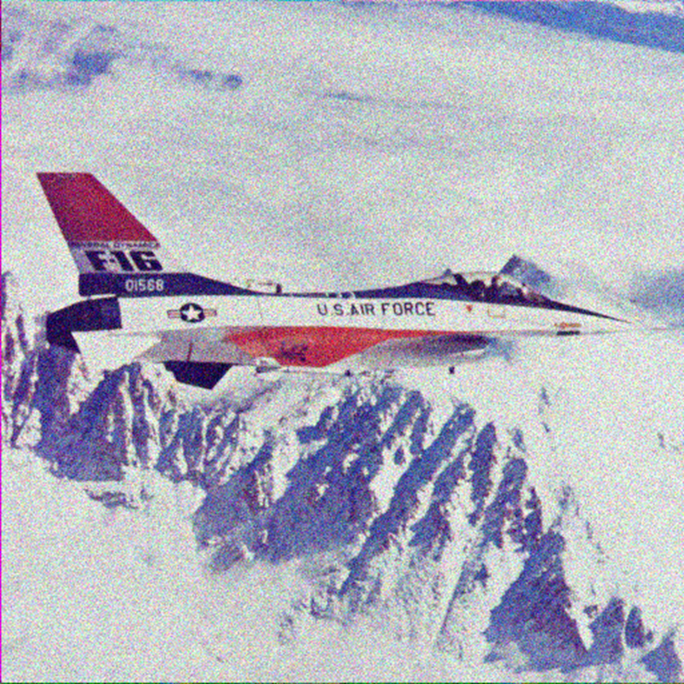
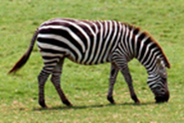
Blind denoising, SR

Slide 4
Deep Image Prior
Ulyanov, D., Vedaldi, A., & Lempitsky, V. “Deep Image Prior.” Proceedings of the IEEE conference on computer vision and pattern recognition(CVPR). 2018.
.

Slide 5
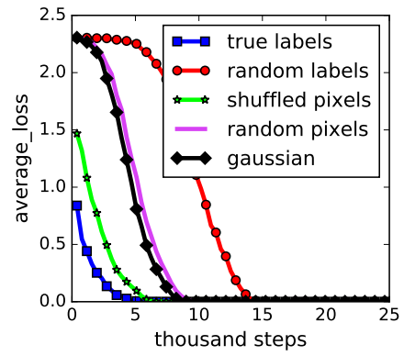
Deep image prior
Understanding how CNN works
CNN performs well → learn realistic image priors from a large number of example images
CNN can overfit to random label!
The structure of network
Zhang, C., Bengio, S., Hardt, M., Recht, B., & Vinyals, O. (2017). Understanding deep learning requires rethinking generalization. ICLR.

Slide 6
Deep image prior
the structure of a generator network is sufficient to capture a great deal of low-level image statistics prior to any learning
a randomly-initialized neural network can be used as a handcrafted prior with excellent results in standard inverse problems such as denoising, superresolution, and inpainting

Slide 7
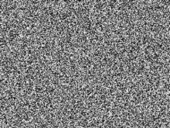

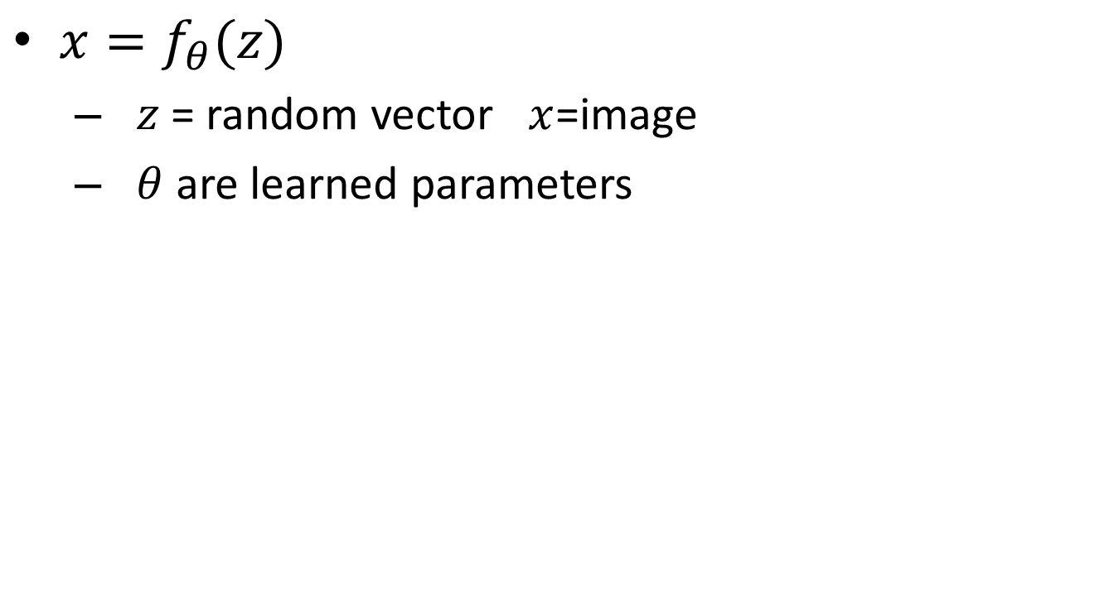
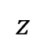
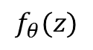
Image generation
$x=f_{θ}(z)$
$z$ = random vector $x$=image
$θ$ are learned parameters
$$f_{θ}(z)$$
$$z$$

Slide 8

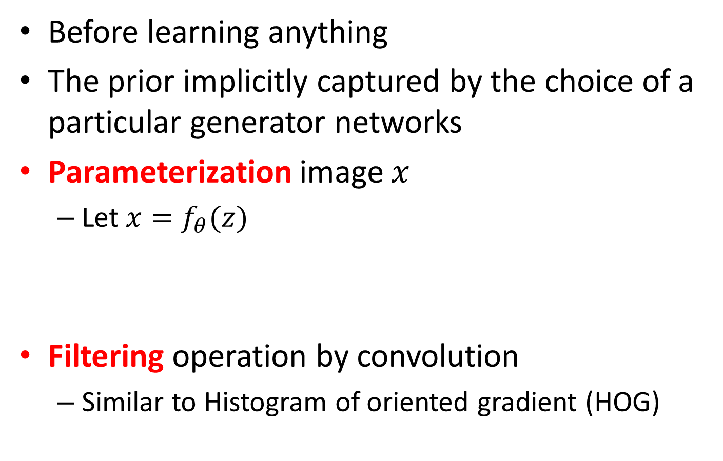
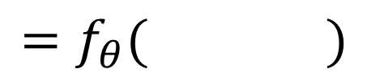
Network Architecture
Before learning anything
The prior implicitly captured by the choice of a particular generator networks
Parameterization image $x$
Let $x=f_{θ}(z)$
Filtering operation by convolution
Similar to Histogram of oriented gradient (HOG)
$$=f_{θ}( )$$

Slide 9
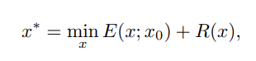
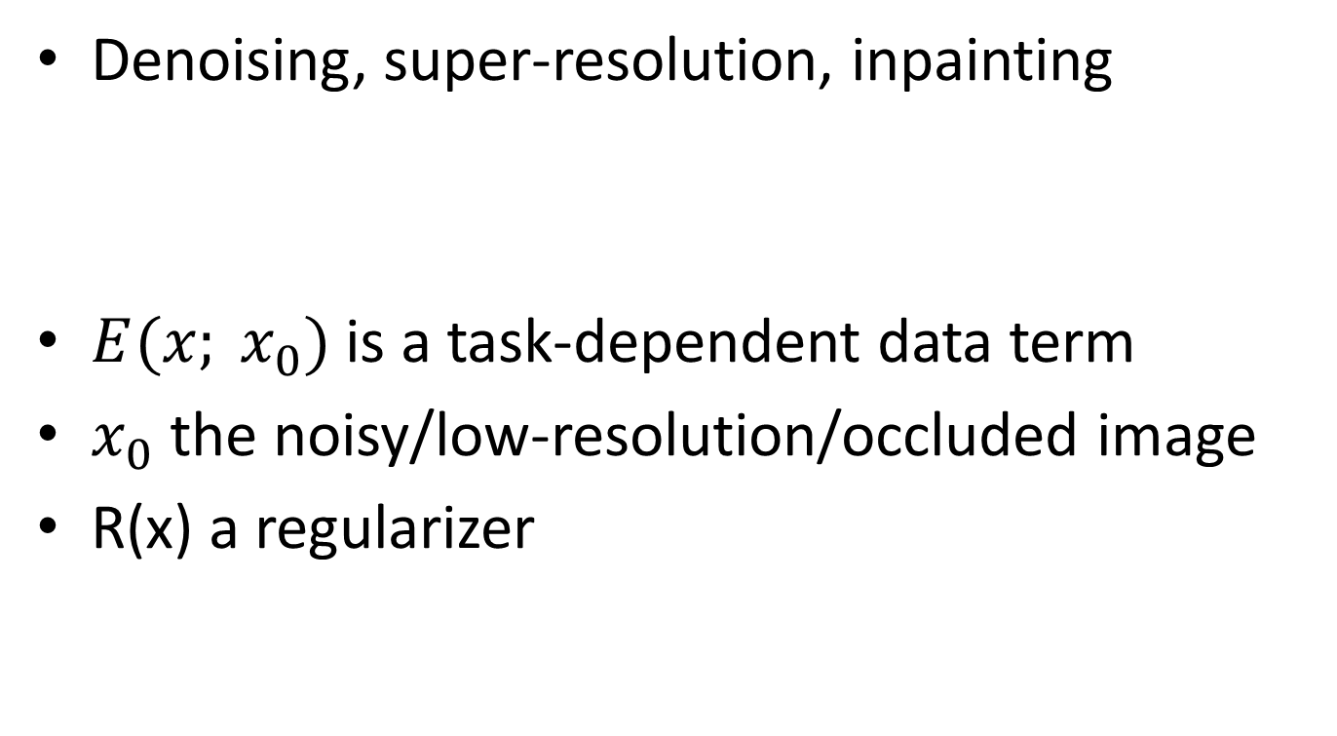
Inverse problems
Denoising, super-resolution, inpainting
$E(x; x_{0})$is a task-dependent data term
$x_{0}$ the noisy/low-resolution/occluded image
R(x) a regularizer

Slide 10
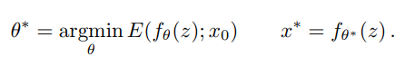
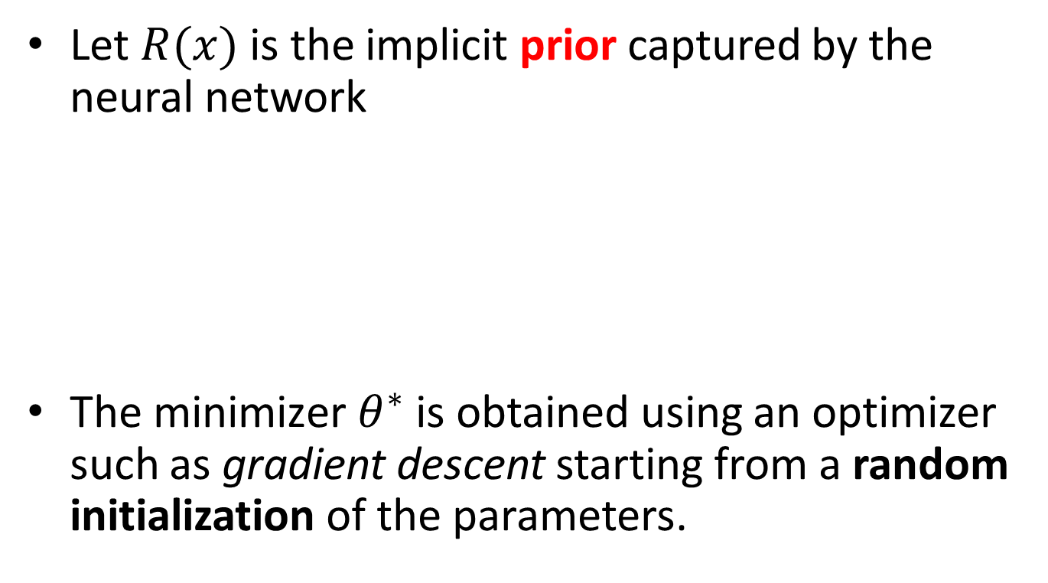
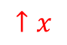
Inverse problems
Let $R(x)$ is the implicit prior captured by the neural network
${\text{The} \text{minimizer} θ}^{∗}$ is obtained using an optimizer such as gradient descent starting from a random initialization of the parameters.
$$↑x$$

Slide 11

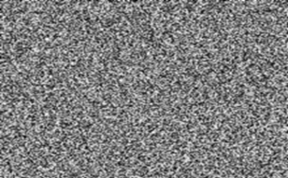
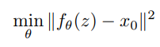
Requirement 1
CNN can fit to any image?
Including white noise?
MSE error
Hourglass network

Slide 12
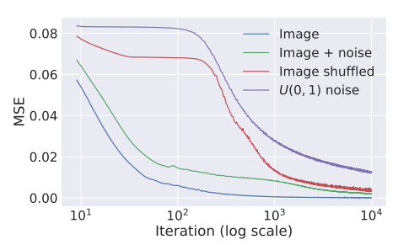
Requirement 1
A parametrization with high noise impedance
CNN 天生就理解自然影像

Slide 13
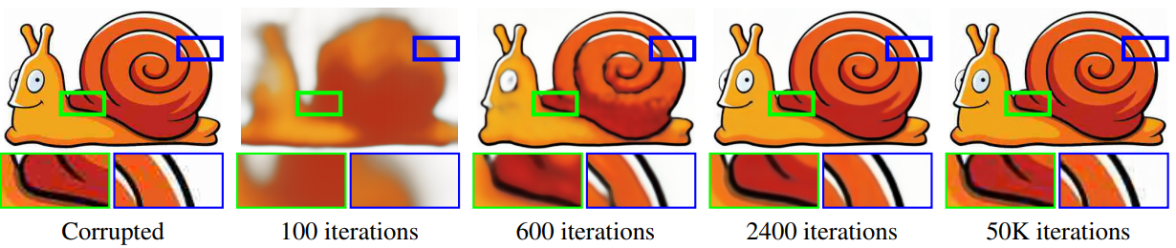
Denoising
Learned
noise

Slide 14
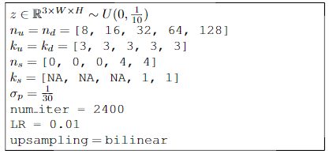
Requirement 1
Network architecture
*自然影像自己找喜歡的
Optimzer: Adam
Add Gaussian noise to z in each iteration
nn.Upsample

Slide 15
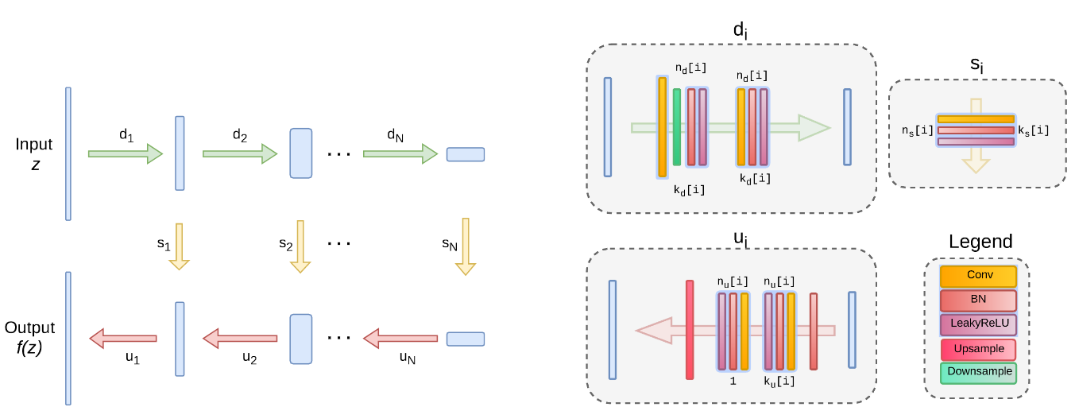
Architecture Guide

Slide 16
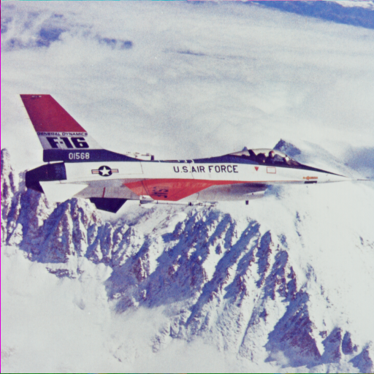


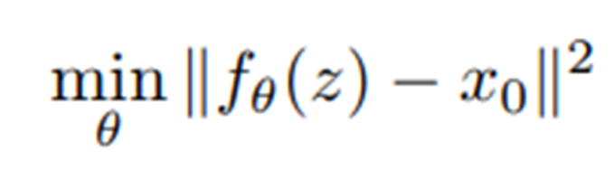
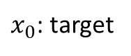
Requirement 2
Blind Denoising
Ground Truth
$x_{0}$: target
output image
PSNR=20.37dB
PSNR =30~31dB

Slide 17
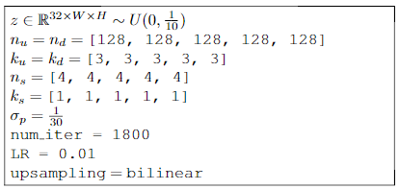
Requirement 2
Blind Denoising
影像請至E3下載
Optimzer: Adam
skip
Add Gaussian noise to z in each iteration

Slide 18
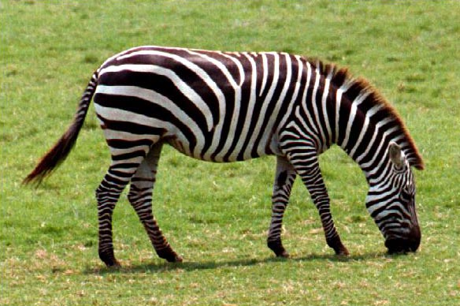
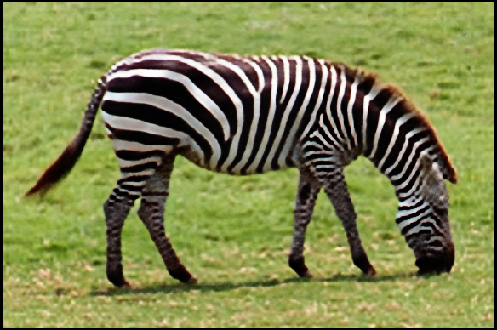
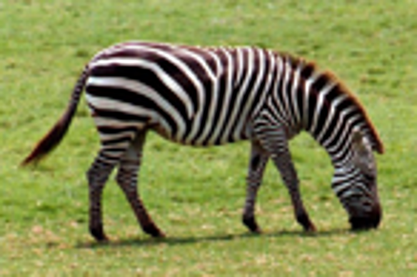
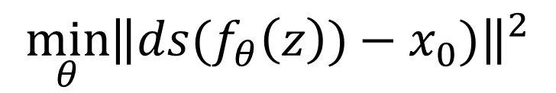
Requirement 3
Blind super-resolution
Ground Truth
output image
bicubic
PSNR ~= 24dB
$$\min_{θ}{{\left\|ds(f_{θ}\left(z\right))−x_{0})\right\|}^{2}}$$
Downsample method: Lanczos

Slide 19
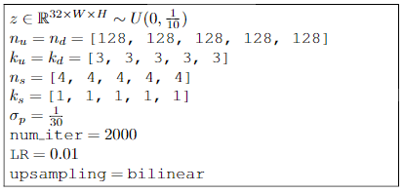
Requirement 3
Blind super-resolution
影像、Downsampler
請至E3作業下載
Optimzer: Adam

Slide 20
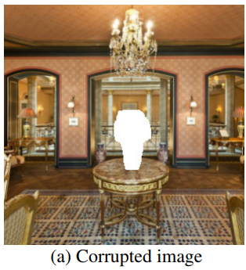
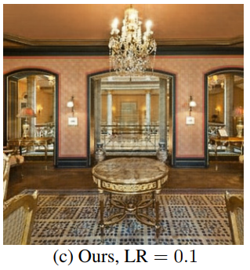
Extra Bonus (+2)
Inpainting

Slide 21
Report Spec: [black: Demo, Gray: No Demo]
1. Introduction (5%)
2. Experiment setup (5%)
The detail of your model
Report all your training hyper-parameters
3. Result
Requirement 1 (10%, 20%)
Training loss curve (you need to record training loss every iteration)
Requirement 2 (10%, 20%)
Visualize the progress of inverted image
Final image and its PSNR
Requirement 3 (10%, 20%)
Visualize the progress of inverted image
Final image and its PSNR
4. Discussion (10%, 20%)
Demo (50%)
Demo會給其他圖案，用你的程式重現實驗

Slide 22
---- Criterion of result (denoising)(20%) ----
PSNR > 30 dB = 100%
PSNR 28.5~30 dB = 90%
PSNR 27~28.5 dB = 80%
PSNR < 27 dB = 70%
---- Criterion of result (super-resolution)(20%) ----
PSNR > 23 dB = 100%
PSNR 21.5~23 dB = 90%
PSNR 20~21.5 dB = 80%
PSNR < 20 dB = 70%
PSNR計算請使用
from skimage.measure import compare_psnr
評分標準: 40%*實驗結果 + 60%*(報告+DEMO)

